Slide 1



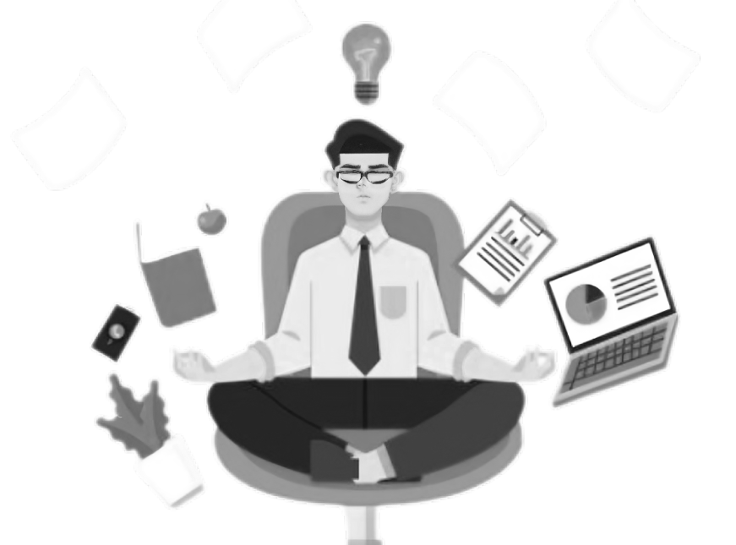
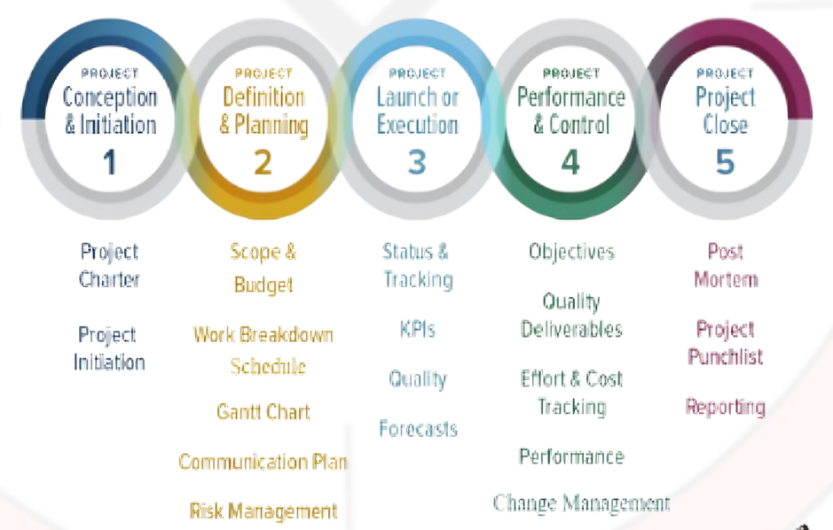



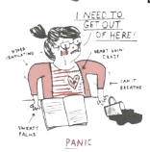
HANDLING PRESSURE IN SOFTWARE ENGINEERING AND PROJECT MANAGEMENT
1. Mihir Gediya (40272399) 2. Pritesh Mangukiya (40291924)
PRESSURE EFFECTS
PRESSURE HANDLING
Pressure in software engineering and project management leads to reduced decision-making quality, increased errors, lowered team morale, and compromised product quality.
WIDELY USED TECHNOLOGIES
Agile Methodology:
Emphasize iterative development and feedback
Effective Communication
Utilize regular meetings and daily stand-ups
Risk Management Practices
Proactively identify and mitigate risks
Implement risk assessment and tracking
Time Management Strategies
Prioritize tasks and set realistic deadlines
Use time-tracking tools like Trello or Asana
Stress Reduction Techniques
Practice mindful meditations and take regular breaks
Conflict Resolution Skills
Practice active listening and empathy
Adaptive Leadership
Remain flexible, empathetic and supportive during pressure
Task Delegation
Prioritize tasks to team members’ strengths
Celebrating Achievements
Recognize and celebrate milestones and success
Continuous Improvement
Implement improvements based on past experiences
In software engineering and project management, effective pressure handling is essential to sustaining output, guaranteeing code quality, and creating a collaborative atmosphere, all of which eventually contribute to successful project outcomes.
PRESSURE AND NEED TO BE HANDLED
The invisible force that turns everyday tasks into olympic-level challenges and deadlines into adrenaline-fueled roller-coaster rides.
According to the American Psychological Association around 77% of people regularly experience physical symptoms caused by stress.
PHYSICAL EFFECTS
Cardiovascular Issues
Weakened Immune System
Chronic Diseases
MENTAL EFFECTS
Anxiety and Depression
Burnout
Sleep Disturbance
BEHAVIORAL EFFECTS
Substance Abuse
Social Withdrawal
PROFESSIONAL EFFECTS
Decreased Productivity
Increased Errors
Reduced Creativity
Negative Impact on Decisions
Unhealthy Talks
ACADEMIC EFFECTS
Test Anxiety
Procrastinations
Difficulty Retaining Information
Impaired Learning
Focus Problem
It is crucial to put in place support mechanisms that strike a balance between high demands and team well-being since pressure in software engineering and project management may undermine productivity and code quality while also contributing to burnout.

